Slide 1
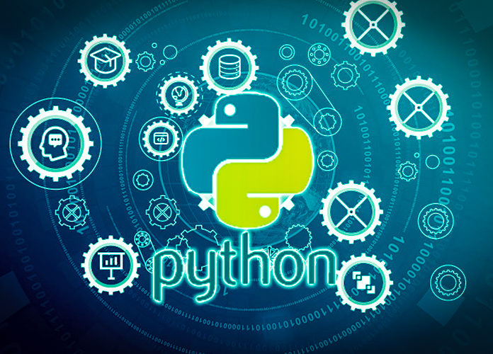
Data Programming in Python _________________ Module 4 Overview

Slide 2

BAIS 6040: Data Programming in Python
Module Objectives:
Reading and Writing Files
Pandas Data Structures
Distinguish between Modules and Packages

Slide 3
BAIS 6040: Data Programming in Python
In this module:
Reading and writing CSV, JSON files
Pandas Series and Dataframes
Python modules
Python packages

